Slide 1
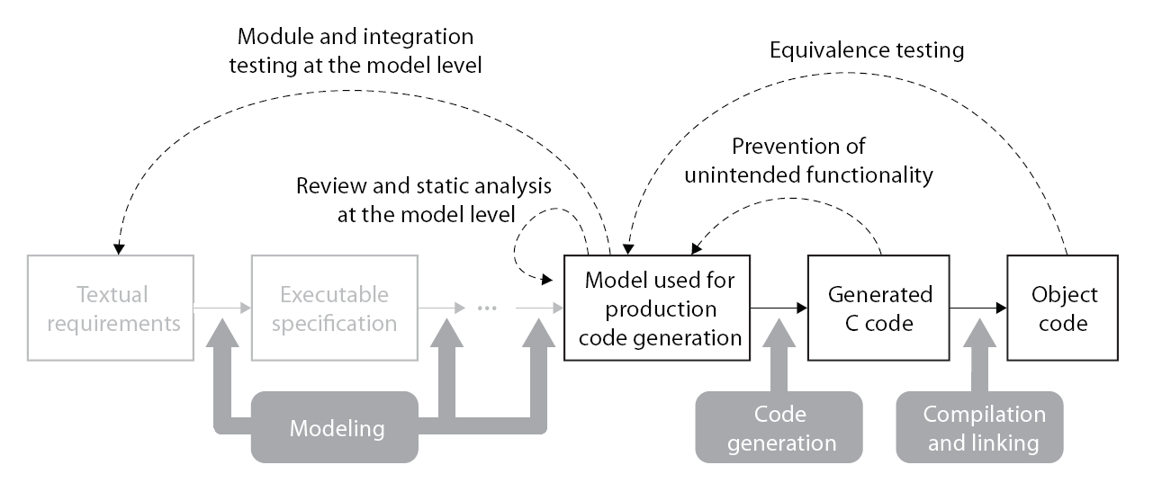
MathWorks ISO 26262 Workshop
MathWorks Reference Workflow with TÜV SÜD Qualification
Upper Process Lower Process
Correspondence between ISO 26262 Tables and MathWorks Reference Workflow
Table 2 − Notations for Software Architectural Design
Table 3 − Principles for Software Architectural Design
Table 7 − Notations for Software Unit Design
Table 6 − Methods for Verification of Software Architectural Design
Table 9 − Methods for Verification of Software Unit Design and Implementation
Table 10 − Methods for Software Unit Testing
Table 11 − Methods for deriving test cases for software unit testing
Table 12 − Structural Coverage Metrics at the Software Unit Level
Table 13 − Methods for Software Integration Testing
Table 14 − Methods for deriving test cases for software integration testing
Table 12 − Structural Coverage Metrics at the Software Unit Level
Table 15 − Structural Coverage Metrics at the Software Architectural Level
ISO 26262 Deliverables Generated from MATLAB/Simulink Productions
Simulink | Stateflow
Simulink Verification and Validation | Simulink Report Generator
Simulink | Stateflow
Simulink Fixed-Point | Simulink Design Verifier
Simulink Verification and Validation | Simulink Report Generator
Simulink | Stateflow
Simulink Fixed-Point | Simulink Design Verifier
Simulink Verification and Validation | Simulink Report Generator
Embedded Coder | Polyspace
- Simulink models with Hierarchical Structure
- Stateflow Charts
- Model Dependency Viewer Reports
- Model Advisor Reports
- The text specification inside Doc Block or Model Info Block
- Reports Generated from Simulink Report Generator
…
- Simulink models with Hierarchical Structure
- Stateflow Charts
- SVG Format Files for showing Simulink Model Information inside Web Brower
- Model Advisor Reports
- Reports Generated from Simulink Report Generator
- System Design Description Report
- Traceability Reports for Requirements
- Test Cases Generated from SLDV
- Harness Model for Test and Verification
- Model Coverage Reports
…
- Test Cases Generated from SLDV
- Harness Model for Test and Verification
- Model Coverage Reports
- Code Coverage Reports
- SIL Model for Back2Back Test
- PIL Model for Back2Back Test
…

Slide 2
IEC Certification Kit Templates for ISO 26262 Certification
Conformance Demonstration Template (IEC Certification Kit)
Paste the MATLAB/Simulink Deliverables to the Templates
Documentations for ISO26262 Certification

Slide 3
Using Simulink for Software Design Session
MathWorks Reference Workflow with TÜV SÜD Qualification
Upper Process Lower Process
Correspondence between ISO 26262 Tables and MathWorks Reference Workflow
Table 2 − Notations for Software Architectural Design
Table 3 − Principles for Software Architectural Design
Table 7 − Notations for Software Unit Design
Table 6 − Methods for Verification of Software Architectural Design
Table 9 − Methods for Verification of Software Unit Design and Implementation
Table 10 − Methods for Software Unit Testing
Table 11 − Methods for deriving test cases for software unit testing
Table 12 − Structural Coverage Metrics at the Software Unit Level
Table 13 − Methods for Software Integration Testing
Table 14 − Methods for deriving test cases for software integration testing
Table 12 − Structural Coverage Metrics at the Software Unit Level
Table 15 − Structural Coverage Metrics at the Software Architectural Level
ISO 26262 Deliverables Generated from MATLAB/Simulink Productions
Simulink | Stateflow
Simulink Verification and Validation | Simulink Report Generator
Simulink | Stateflow
Simulink Fixed-Point | Simulink Design Verifier
Simulink Verification and Validation | Simulink Report Generator
Simulink | Stateflow
Simulink Fixed-Point | Simulink Design Verifier
Simulink Verification and Validation | Simulink Report Generator
Embedded Coder | Polyspace
- Simulink models with Hierarchical Structure
- Stateflow Charts
- Model Dependency Viewer Reports
- Model Advisor Reports
- The text specification inside Doc Block or Model Info Block
- Reports Generated from Simulink Report Generator
…
- Simulink models with Hierarchical Structure
- Stateflow Charts
- SVG Format Files for showing Simulink Model Information inside Web Brower
- Model Advisor Reports
- Reports Generated from Simulink Report Generator
- System Design Description Report
- Traceability Reports for Requirements
- Test Cases Generated from SLDV
- Harness Model for Test and Verification
- Model Coverage Reports
…
- Test Cases Generated from SLDV
- Harness Model for Test and Verification
- Model Coverage Reports
- Code Coverage Reports
- SIL Model for Back2Back Test
- PIL Model for Back2Back Test
…

Slide 4
Design verification Session
MathWorks Reference Workflow with TÜV SÜD Qualification
Upper Process Lower Process
Correspondence between ISO 26262 Tables and MathWorks Reference Workflow
Table 2 − Notations for Software Architectural Design
Table 3 − Principles for Software Architectural Design
Table 7 − Notations for Software Unit Design
Table 6 − Methods for Verification of Software Architectural Design
Table 9 − Methods for Verification of Software Unit Design and Implementation
Table 10 − Methods for Software Unit Testing
Table 11 − Methods for deriving test cases for software unit testing
Table 12 − Structural Coverage Metrics at the Software Unit Level
Table 13 − Methods for Software Integration Testing
Table 14 − Methods for deriving test cases for software integration testing
Table 12 − Structural Coverage Metrics at the Software Unit Level
Table 15 − Structural Coverage Metrics at the Software Architectural Level
ISO 26262 Deliverables Generated from MATLAB/Simulink Productions
Simulink | Stateflow
Simulink Verification and Validation | Simulink Report Generator
Simulink | Stateflow
Simulink Fixed-Point | Simulink Design Verifier
Simulink Verification and Validation | Simulink Report Generator
Simulink | Stateflow
Simulink Fixed-Point | Simulink Design Verifier
Simulink Verification and Validation | Simulink Report Generator
Embedded Coder | Polyspace
- Simulink models with Hierarchical Structure
- Stateflow Charts
- Model Dependency Viewer Reports
- Model Advisor Reports
- The text specification inside Doc Block or Model Info Block
- Reports Generated from Simulink Report Generator
…
- Simulink models with Hierarchical Structure
- Stateflow Charts
- SVG Format Files for showing Simulink Model Information inside Web Brower
- Model Advisor Reports
- Reports Generated from Simulink Report Generator
- System Design Description Report
- Traceability Reports for Requirements
- Test Cases Generated from SLDV
- Harness Model for Test and Verification
- Model Coverage Reports
…
- Test Cases Generated from SLDV
- Harness Model for Test and Verification
- Model Coverage Reports
- Code Coverage Reports
- SIL Model for Back2Back Test
- PIL Model for Back2Back Test
…

Slide 5
Code Verification Session
MathWorks Reference Workflow with TÜV SÜD Qualification
Upper Process Lower Process
Correspondence between ISO 26262 Tables and MathWorks Reference Workflow
Table 2 − Notations for Software Architectural Design
Table 3 − Principles for Software Architectural Design
Table 7 − Notations for Software Unit Design
Table 6 − Methods for Verification of Software Architectural Design
Table 9 − Methods for Verification of Software Unit Design and Implementation
Table 10 − Methods for Software Unit Testing
Table 11 − Methods for deriving test cases for software unit testing
Table 12 − Structural Coverage Metrics at the Software Unit Level
Table 13 − Methods for Software Integration Testing
Table 14 − Methods for deriving test cases for software integration testing
Table 12 − Structural Coverage Metrics at the Software Unit Level
Table 15 − Structural Coverage Metrics at the Software Architectural Level
ISO 26262 Deliverables Generated from MATLAB/Simulink Productions
Simulink | Stateflow
Simulink Verification and Validation | Simulink Report Generator
Simulink | Stateflow
Simulink Fixed-Point | Simulink Design Verifier
Simulink Verification and Validation | Simulink Report Generator
Simulink | Stateflow
Simulink Fixed-Point | Simulink Design Verifier
Simulink Verification and Validation | Simulink Report Generator
Embedded Coder | Polyspace
- Simulink models with Hierarchical Structure
- Stateflow Charts
- Model Dependency Viewer Reports
- Model Advisor Reports
- The text specification inside Doc Block or Model Info Block
- Reports Generated from Simulink Report Generator
…
- Simulink models with Hierarchical Structure
- Stateflow Charts
- SVG Format Files for showing Simulink Model Information inside Web Brower
- Model Advisor Reports
- Reports Generated from Simulink Report Generator
- System Design Description Report
- Traceability Reports for Requirements
- Test Cases Generated from SLDV
- Harness Model for Test and Verification
- Model Coverage Reports
…
- Test Cases Generated from SLDV
- Harness Model for Test and Verification
- Model Coverage Reports
- Code Coverage Reports
- SIL Model for Back2Back Test
- PIL Model for Back2Back Test
…

